Slide 1
Faculty Activity System: Faculty & Staff Essential Skills Training

Slide 2
Agenda
Introductions
Product Introduction
Campus Goals and Expectations
Essential Skills and Best Practices
Next Steps and Q&A

Slide 3
How do we see the bigger picture?
How do we move…
From This...
...To This
Paper-based, out-of-date
Complex, static reports
Faculty data silos
Home-grown tools
Overextended staff lacking system knowledge
Data-led, real-time
Actionable analytics and insights
Unified data shared across integrated systems
Industry standards
Intuitive, easy-to-use solutions that support processes

Slide 4
Capture faculty achievements once, use them infinitely
Faculty Accomplishments by Watermark
From… |  | …To
Faculty are repeatedly asked to provide the same data for different purposes (on average, 8-10 times per year). |  | Rise above the noise of data entry by eliminating duplicate effort and creating a single data set for accreditation and activity reporting.
Faculty spend countless hours entering activity data related to teaching, scholarship, and service, often manually transcribed from their CV. |  | Reduce manual data entry for faculty by 80% with CV Imports, which allows fast and easy import and validation of faculty achievement information.
Faculty annual reviews and promotion & tenure processes require faculty to compile and deliver physical dossiers for review. |  | Create a holistic, digitized view of faculty achievement data and easily customize workflows to better orchestrate annual review and promotion & tenure that can be conducted anytime, anywhere.
Faculty profile pages on the website are out-of-date as soon as the new information goes live. |  | Count on a connected suite of Watermark solutions that integrate with your website’s CMS to update faculty profiles in real time.
Trusted by:

Slide 5
Faculty Accomplishments by Watermark
Faculty Accomplishments is a streamlined system for managing and reporting on faculty activity information for accreditation, annual review, promotion and tenure, and more.
Save time and energy by ensuring that accurate data on faculty’s teaching, research publications, professional development, and service activities is always at your fingertips.
Faculty Accomplishments by Watermark makes it easy to:
Quickly generate reports for institutional leaders and external stakeholders
Track teaching, research, and service activity while managing faculty workloads
Create customized CVs for faculty from every discipline
Import data from existing campus systems, including information on courses taught and grants
Publish up-to-date faculty profiles on your campus website

Slide 6
Campus Goals and Expectations

Slide 7
Campus Expectations of Faculty
System Access
Access system at: https://facdev.ouhsc.edu/Resources/OUHSC-Faculty-Activity-System
Use your OU SSO log-in (same as your email and computer login)
Data Entry
Check with your department/college on how often data must be entered
At minimum, we recommend quarterly
Reports
Run your CV or annual report prior to deadlines to determine if there are any glitches
Report revision needs as soon as possible to: OUHSC-IPE@ouhsc.edu.

Slide 8
Essential Skills and Best Practices
Notes:
CSM Leads

Slide 9
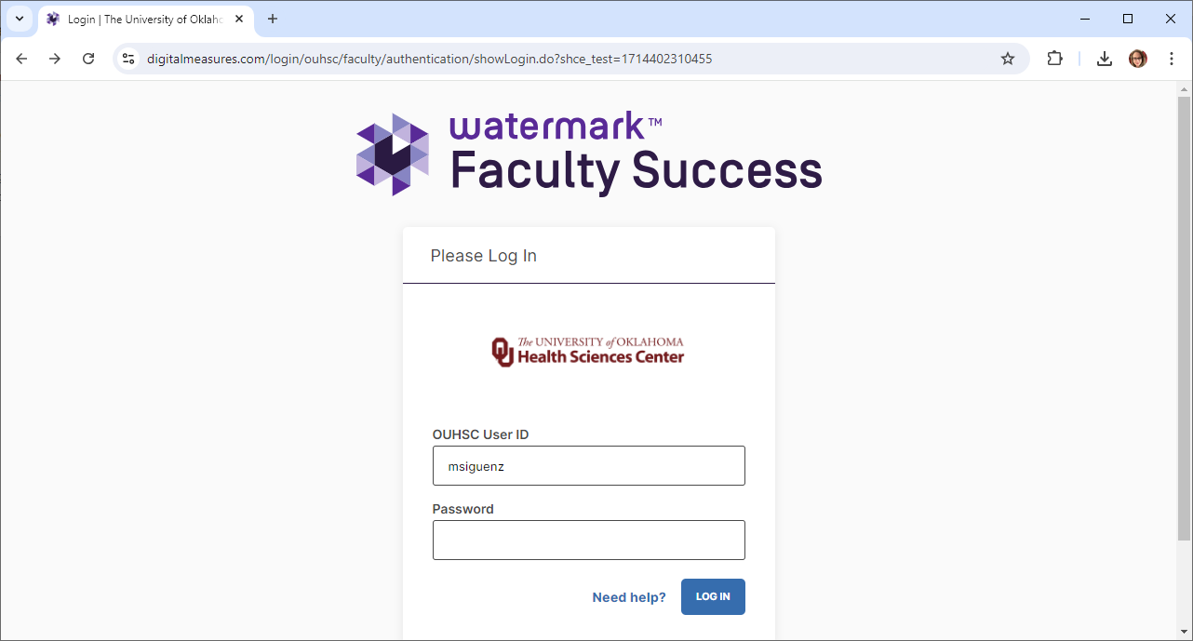
Logging into Faculty Accomplishments is Easy!
LINK: https://www.digitalmeasures.com/login/ouhsc/faculty/authentication/showLogin.do?shce_test=1714402310455 .

Slide 10
Tips and Reminders for Logging In
Use Single Sign-On (SSO) for Faculty Accomplishments:
Use the SSO link provided by Watermark.
FAS Link

Slide 11
Navigation Bar
The navigation bar displays at least two main utilities: Activities and Reports. You may have other utilities if your Faculty Accomplishments Administrator has given you the appropriate security role.
Activities: Add or update information about your activities and accomplishments.
Reports: Run reports that have been custom-built for your campus or create your own reports.
Help: The question mark icon allows you to submit questions, send suggested improvements for the system, or report system errors.
Notes:
Note for System Admin: You may want to show these options live

Slide 12
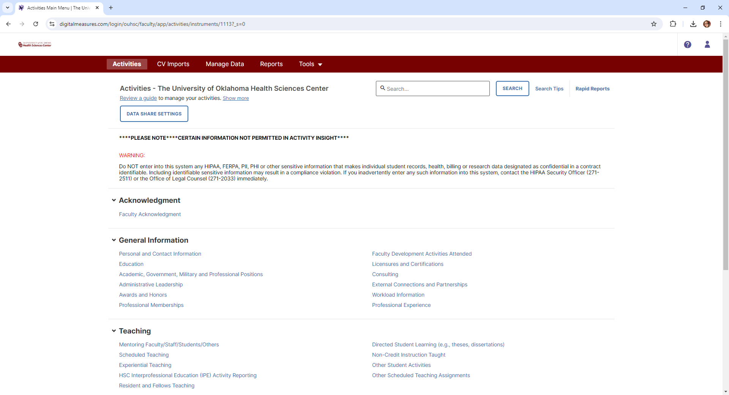
Activities Screen
Notes:
Note for System Admin: You may want to show the Activities Screen live and discuss what has been entered for faculty and what expectations are in place for them

Slide 13
Activities Overview
We recommend you take a few minutes to familiarize yourself with the screens available (for example, Administrative Data, Career Information, etc.).
To access a screen, simply click the screen name. The resulting summary screen displays records that are stored for that screen. There are several actions you can take from the resulting screen (not all of these actions will be available):
To add a new record, click Add New Item.
To import items in bulk, click Import Items (available only on the Intellectual Contributions screen).
To edit or view a record, click anywhere in the record row on the summary screen.
Note: Your Faculty Accomplishments Administrator may have added records to the system for you. These records can be viewed, and in most cases, edited. However, some fields may have access restrictions and therefore cannot be edited. If revisions are needed to restricted records, contact your Faculty Accomplishments Administrator using the Help link.
Notes:
System Admin - you may want to consider creating a slide for each bullet point and demonstrating how to complete each action; Screenshots from your Faculty Accomplishments system may be helpful here.

Slide 14
Importing Data
There are two ways for you to bring citations into Faculty Accomplishments from other databases.
Load BibTeX files into Faculty Accomplishments example, EndNote, Google Scholar, Mendeley, RefWorks, HeinOnline, or Zotero). For more information on BibTeX Imports, please visit this page.
Import directly from Crossref and PubMed, ORCID, Scopus, and Web of Science. Visit this page for details on this feature.

Slide 15
Reports: Creating a CV
Reporting Basics and CV Customization Guide

Slide 16
Self-Service Reports: Rapid Reports
While you are managing your activities, you may want to see how a particular change looks on a report. Rapid Reports gives you quick and easy access to the reports available in Faculty Accomplishments.

Slide 17
CV Import Tool
CV Import Tool Instructions

Slide 18
Help Tools
If you need help with the Activities Screen, click Review a Guide.
Click ? in the top right corner of your account to access additional help resources.

Slide 19
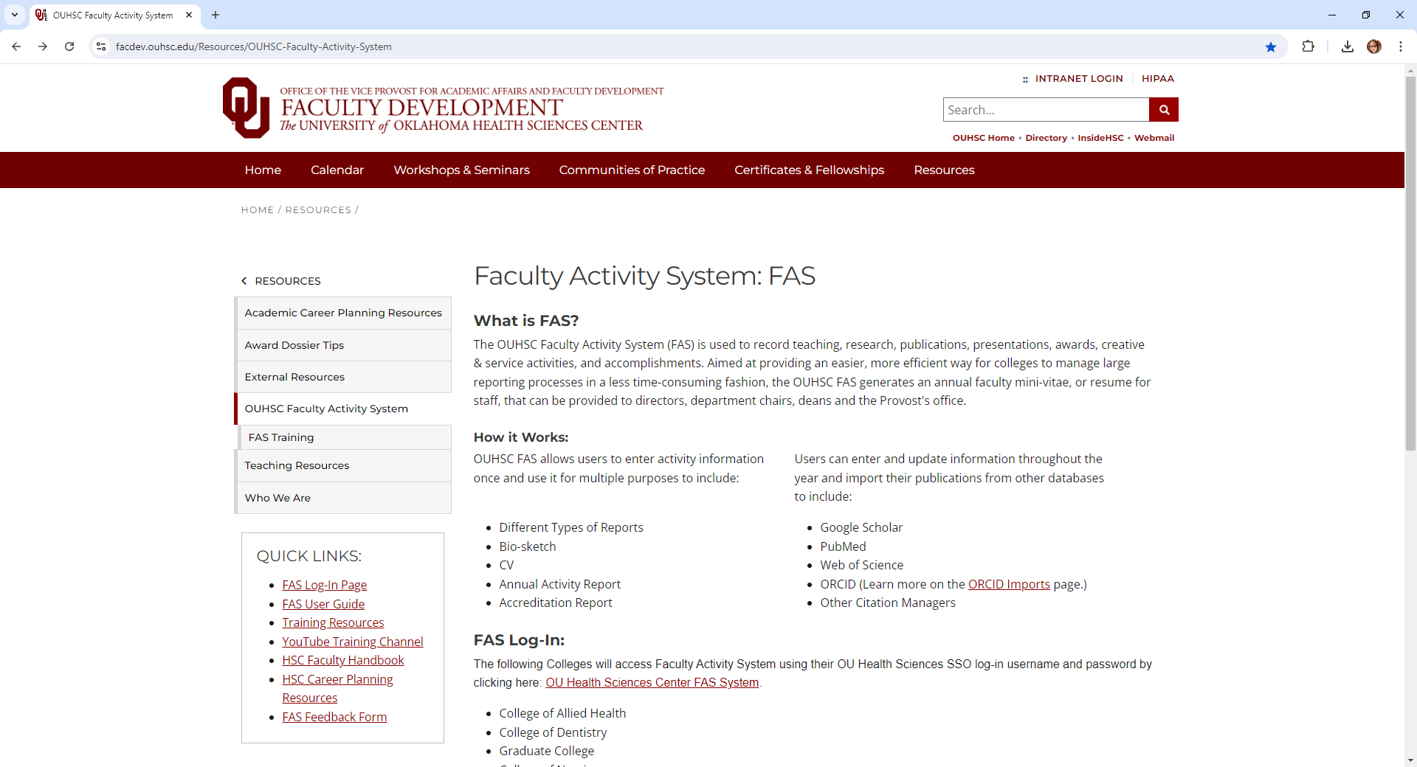
Help Tools
OUHSC Webpage: https://facdev.ouhsc.edu/Resources/OUHSC-Faculty-Activity-System

Slide 20
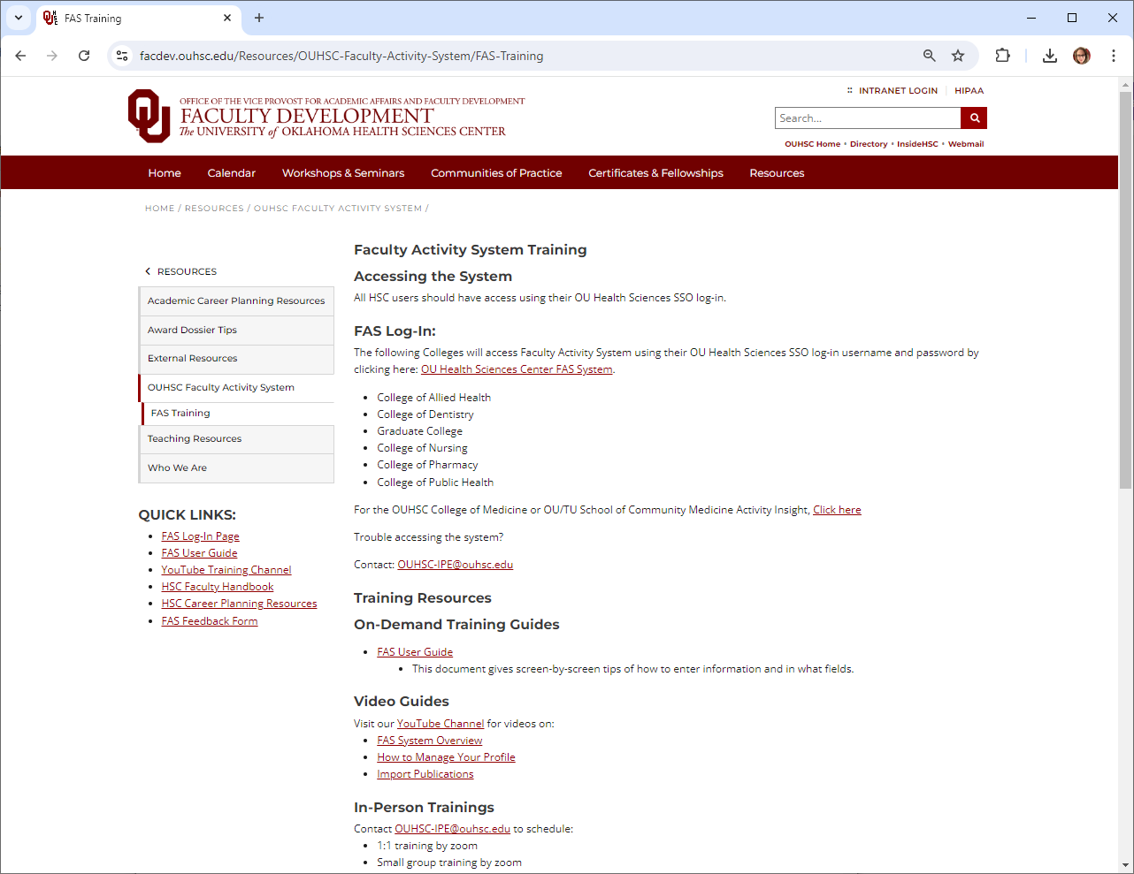
Help Tools
OUHSC Training Page
Training Guides
Video Guides
Help Email Links
https://facdev.ouhsc.edu/Resources/OUHSC-Faculty-Activity-System/FAS-Training

Slide 21
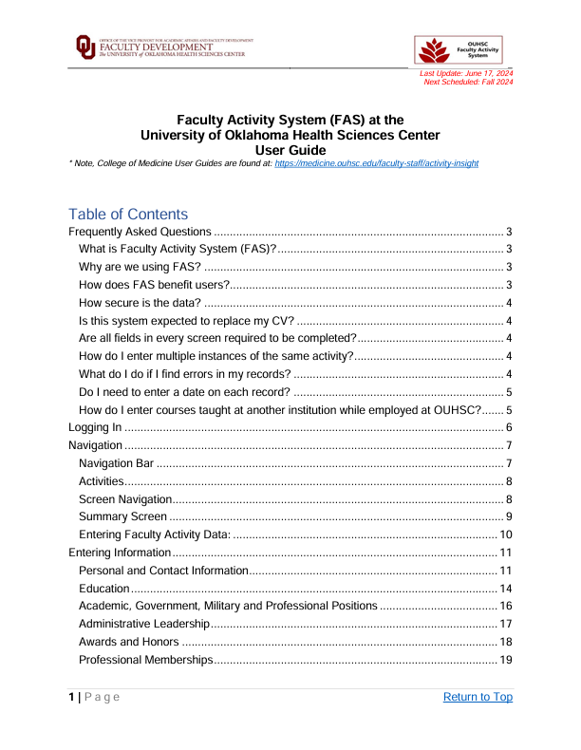
Help Tools
OUHSC Training Guide
https://facdev.ouhsc.edu/Resources/OUHSC-Faculty-Activity-System under Quick Links
Screenshots and step-by-step instructions

Slide 22
Contact:
OUHSC-IPE@ouhsc.edu

